Slide 1
WEEK Three:
Project Delivery Systems & Contract Risk Management
Notes:
Welcome to our second Small Business Training Class. Thank you for joining us. I’m James Summers and this is Pastor Hardie Blake.

Slide 2
Last Week
10 steps to start your business
Conduct market research
Write your business plan
Fund your business
7 Register your business
8 Get federal and state tax IDs
9 Apply for licenses and permits
10 Open a business bank account
Pick your business location
Choose a business structure
Choose your business name

Slide 3
Project Delivery Systems and
Contract Risk Management

Slide 4
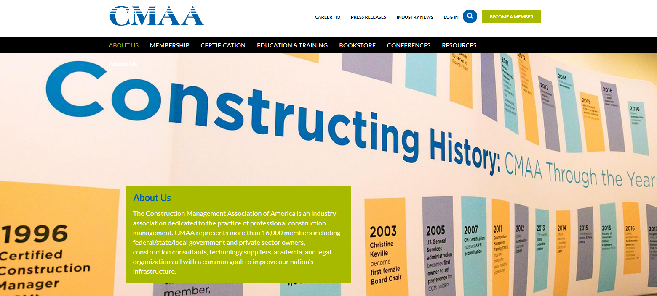
The Construction Management Association of America
https://www.cmaanet.org
Note example of projects: Transportation
Notes:
The Construction Management Association of America is an industry association dedicated to the practice of professional construction management. CMAA represents more than 16,000 members including federal/state/local government and private sector owners, construction consultants, technology suppliers, academia, and legal organizations all with a common goal: to improve our nation's infrastructure.
Delivering Dispute Free Constrution Projects - Part I - Planning, Design & Bidding

Slide 5
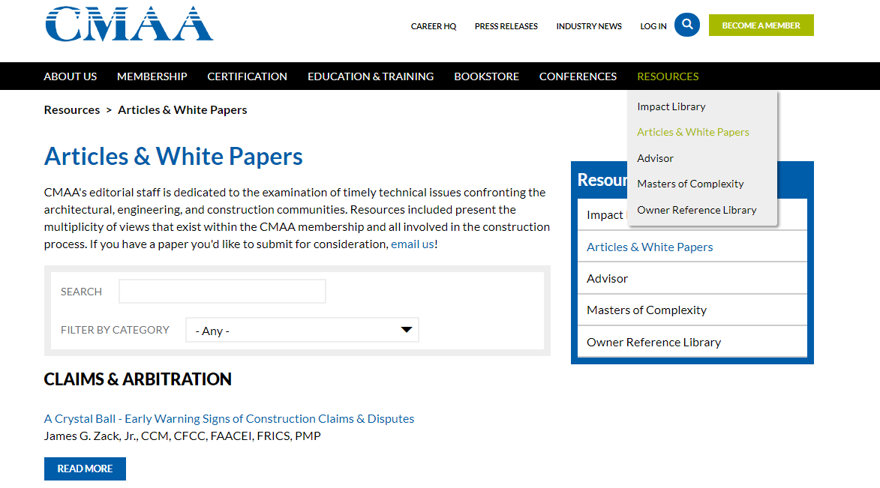
Resource tab
Articles &
Whitepapers
The Construction Management Association of America
https://www.cmaanet.org
Note example of projects: Transportation
Notes:
The Construction Management Association of America is an industry association dedicated to the practice of professional construction management. CMAA represents more than 16,000 members including federal/state/local government and private sector owners, construction consultants, technology suppliers, academia, and legal organizations all with a common goal: to improve our nation's infrastructure.
Delivering Dispute Free Constrution Projects - Part I - Planning, Design & Bidding

Slide 6
Construction Management Professionals
Oversight
Owner
Architect
General Contractor
Trade Contractors
Sub Contractors
Advise
Oversee Construction
Share risk
Assure success
Notes:
A Construction Manager
collaborates with and provides oversight to the owner, the architect, the general contractor, trade contractors and/or subcontractors to deliver the project on time, at or under budget, and to the owner's expected standard of quality.
Typically, do not perform the actual construction tasks themselves, but either act as advisors directly to the owner overseeing construction contracts or
Operate “at risk”, being contractually obligated for delivering the entire project.
CM is charged with assuring the project progresses smoothly and achieves the owner’s business objective

Slide 7
Construction Management is leading teams
The CM often leads a team of specialists.
scheduling,
safety,
cost estimating,
design,
quality assurance,
value engineering,
commissioning,
construction inspection,
risk management, and more.
Most CMs have backgrounds in civil engineering; many are contractors or architects.
Notes:
The CM often leads a team of specialists.
scheduling,
safety,
cost estimating,
design,
quality assurance,
value engineering,
commissioning,
construction inspection,
risk management, and more.
Most CMs have backgrounds in civil engineering; many are contractors or architects and use a Design-Bid-Build project management system

Slide 8
Projects Phases
THE PLANNING PHASE
THE DESIGN PHASE
THE BIDDING PHASE

Slide 9
THE PLANNING PHASE
Activities necessary before full design
business case development
analysis and approval
preliminary project size
scope and location
preliminary budgeting and scheduling
procurement methodology
estimates of profitability and/or ROI
Notes:
The planning phase involves the activities related to the proposed project and the activities necessary before we do the full design. They include business case development, analysis and approval, decisions related to preliminary project size, scope and location, preliminary budgeting and scheduling, decisions concerning procurement methodology, estimates of project profitability and/or Return on Investment (“ROI”) calculations etc.
If the project is to be performed utilizing the Design, Bid and Build delivery method, then the planning phase most likely will include preparation of the bridging documents. If the project is a process facility (i.e., oil, gas, chemicals, etc.) and will be executed using the EPC {Event-Driven Process Chain) process, then the planning phase will likely include front end engineering design (“FEED”) also. We’re going to focus on DBB processes.

Slide 10
THE PLANNING PHASE
Thoroughly Define Scope of Work
Active Stakeholder Involvement
Define Project “Success”
Realistic Budget
Achievable Time of Performance
Manage to Budget
Appropriate Project Delivery Method
Organizational Skills and Gaps
Risk Identification and Analysis
Notes:
Thoroughly Define Scope of Work – what’s Scope? How do you define it? [DISCUSSION]
Active Stakeholder Involvement – Who are stakeholders? How do you involve them? [DISCUSSION]
Define Project “Success” – How do we define success? [DISCUSSION]
Realistic Budget – What’s a realistic budget? How do you know it’s realistic? [DISCUSSION]
Achievable Time of Performance – How do you come up with an achievable time performance? How do you know? [DISCUSSION]
Manage to Budget – How do you manage to the budget? [DISCUSSION]
Appropriate Project Delivery Method – What is a delivery method? How do you decide it’s the right one? [DISCUSSION]
Organizational Skills and Gaps – What are organizational skill gaps? How do you determine them? [DISCUSSION]
Risk Identification and Analysis – What might be the risks? How do you identify them? What do you do to analyze them? [DISCUSSION]

Slide 11
Bridging Documentation
Protects the interests of the project owner
Final design and construction responsibility is on the contractor
Owner is fully protected
Contractor has full design-build responsibility
Efficient, effective, saves time and costs
Public Agencies require more project definition
Notes:
The Bridging method is a proven construction project delivery method. It’s more effective in protecting the interests of the project owner than other methods. It places final design and construction responsibility on the contractor in a design-build form of contract. Unlike the typical design-build contract, however, the owner is fully protected from the outset with all aspects of the design and specifications that are important to the owner, yet the owner ends up having an agreement with the contractor to have a full design-build responsibility.
The Owner’s Design Consultant (“Bridging Architect”) fully protects all aspects of the design and specifications which are important to the owner, while leaving proposing design-build contractors with the opportunity to use their skills and capabilities to provide the owner with the best total price and time of completion proposals.
The construction price under a properly executed Bridging project is not only as reliable for the Owner as a price based on final Contract Documents under the traditional Design-Bid-Build method, it is more dependable because the Owner’s exposure to contractor-initiated change orders due to errors or omissions in the contract documents is dramatically reduced.
All too often change orders cause significant increases in the final construction contract price. Bridging is worthy of consideration for any construction project as an efficient and effective method of project delivery and will save time and money for the owner if properly carried out. You should expect your clients to look for this type of arrangement and should expect it yourself in situations when you are the owner.
To ensure they get what they bought, public agencies typically require more project definition than private owners in bridging documents. Private owners have greater influence when refining the project definition in the final design, because future work will likely be awarded on past performance and personal relationships. Public agencies, on the other hand, have less leverage with D-B contractors due to public bidding laws. Public agencies also have internal customers such as construction, engineering, and maintenance departments that often prefer a higher level of definition and control.

Slide 12
Project definition
provides a basis for bids and agreement
identifies technical issues, risks, and project constraints
conveys lifecycle criteria
avoids unnecessary owner commitments
maximizes innovation opportunities
establishes quality assurance criteria
Notes:
The project definition:
provides a basis for bids and agreement;
identifies technical issues, risks, and project constraints;
conveys lifecycle criteria;
avoids unnecessary owner commitments;
maximizes innovation opportunities; and
establishes quality assurance criteria.
Conveying required elements Defining scope and technical requirements, the project agreement is the sole document defining contractual requirements.
Design elements ‘required’ by the owner must be identified as such.
The bridging documents often include a technical design concept that presents the project scheme and layout. The technical design concept articulates ‘one way’ of designing the project, but not ‘the only way.’ It provides proof of feasibility within the project constraints. The technical design concept represents a five to 30 percent effort level but varies by discipline and project. It can be used to estimate construction costs. The technical design concept is issued by bidders as a ‘no-reliance’ document, but it should not contain errors or be misleading.
The technical design concept, or portions of which are defined as ‘required’ in the project agreement, is used to define scope requirements and measure compliance.
Performance criteria To maximize innovation opportunities, bridging documents employ performance criteria, which are measurable performance attributes of products defining their suitability for installation on a specific project. The more the project description is expressed in performance criteria, the more flexibility the design-builder has in creating an efficient final design.
Innovation Innovation in design-build projects is encouraged when performance criteria is used. Collaboration between the designer and builder also results in innovation. As long as the bridging documents clearly define the project requirements and performance criteria and tests, the owner gains value.

Slide 13
Project definition
Conveying required elements
technical design concept
performance criteria
Innovation
Cost
Schedule
Transparency
Quality Control
Notes:
Conveying required elements Defining scope and technical requirements, the project agreement is the sole document defining contractual requirements. Design elements ‘required’ by the owner must be identified as such.
The bridging documents often include a technical design concept that presents the project scheme and layout. The technical design concept articulates ‘one way’ of designing the project, but not ‘the only way.’ It provides proof of feasibility within the project constraints. The technical design concept represents a five to 30 percent effort level but varies by discipline and project. It can be used to estimate construction costs. The technical design concept is issued by bidders as a ‘no-reliance’ document, but it should not contain errors or be misleading.
The technical design concept, or portions of which are defined as ‘required’ in the project agreement, is used to define scope requirements and measure compliance.
Performance criteria To maximize innovation opportunities, bridging documents employ performance criteria, which are measurable performance attributes of products defining their suitability for installation on a specific project. The more the project description is expressed in performance criteria, the more flexibility the design-builder has in creating an efficient final design.
As an example of performance criteria, the Ottawa Light-rail Transit (OLRT) is a completely new system including tunnels, railway, stations, maintenance facilities, vehicles, and a 30-year maintenance term. The bridging documents for this Canadian project established light-rail system performance criteria of 24,000 people her hour (pph). This allowed the proposing D-B teams to find the most efficient combination of vehicle capacity, headway, and station capacity to meet the performance criteria.
Innovation Innovation in design-build projects is encouraged when performance criteria is used. Collaboration between the designer and builder also results in innovation. As long as the bridging documents clearly define the project requirements and performance criteria and tests, the owner gains value.
Cost Project cost is the critical owner and proposer concern. Bridging documents are used by the owner to develop a construction cost estimate. An accurate bridging cost estimate is essential for the owner’s budgeting, risk analysis, value analysis, and financial models. Bridging documents are used by proposers to develop their cost/bids. The overall level of design in bridging documents, and the level of design in specific project elements, is driven by what information is necessary to get an accurate bid and cost estimate.
Schedule Bridging documents provide proof of feasibility within the project constraints. On longer, more complex projects, and those with long lead items and schedule constraints, it is important to develop an accurate schedule with the bridging documents. The design-build approach results in accelerated project completion—the bridging documents must capture this value for the owner through setting accelerated—but still feasible—milestone and completion dates for the project in the bridging documents.
Transparency The bridging documents should disclose all relevant information to teams bidding on the project. Design-build transfers a lot of the risk from the owner to the D-B team, but it does not eliminate claims. Providing all relevant information reduces claims and results in better bids.
Quality control in the D-B project Quality control (QC) is the sole responsibility of the design-build team. The owner may perform quality assurance (QA) testing or hire an independent QA consultant for acceptance. The bridging documents identify the overall quality planning, controlling, reporting, and auditing requirements. The D-B team is required to prepare a quality plan consistent with these requirements, often prior to selection.
The quality plan must include both construction and design QC components aligned with the owner’s standard requirements. The owner should trust the design-build team’s quality control system, but needs to be smart by requiring independent verification and auditing.

Slide 14
Project definition
Risk allocation
Market conditions
Terms of contract
Procurement process
Selection method
Incentives and disincentives
Alternates
Project selection
Notes:
Risk allocation As the design is only partially complete at the time of bid and must be finished by the design-builder, the owner’s risk related to the design is low. However, the design-builder is in a high-risk position for final design, construction product, quality, and schedule. Its bid is based on the loosely defined bridging documents.
The design-builder produces the final design product and assumes the risk for the final project schedule and the construction activity. Ideally, the project allocates risk to the party best able to manage, price, and insure the risk. Bridging documents are used to allocate risk between the owner and design builder.
Market conditions Conditions in the construction market will affect the response to the request for proposals (RFP). It is important for owners to be able to gage the market conditions and what the construction market will accept. Design-build-operate-maintain, design-build-maintain, and public-private partnerships (P3s) are long-term contracts and have various payment mechanisms. It is particularly important to feel out the market conditions on long-term projects.
For example, the Town of Dartmouth, Massachusetts, requested bids for wind turbine developers. The developers would receive revenue from power purchased by the town, depreciation tax credits, and renewable energy credits (REC) over the 20-year contract term. REC prices vary and can be sold forward in the market, but at a discount. Some bidders sought an adjustment if the renewable energy credit market fell substantially. The town felt the risk of a drop in renewable energy credits was something they would not accept, so it disallowed the contract adjustment. Three compliant bids were received, but some potential bidders chose not to partake.
Terms of contract Since the project agreement is the sole document defining contractual requirements, it is important to have an agreement consistent with the project and owner needs. It is advised to provide a copy or draft of the proposed project agreement with the RFP. The project agreement is the document ultimately defining the project and allocating risk.
Procurement process The procurement process is framed by applicable laws and the owner’s experience with design build. Important decisions in the procurement process are the selection method, handling of alternate designs, and use of incentives and stipends.
Selection method The selection process establishes how design-build proposers exchange information with the owner. Agencies often pre-qualify bidders through a request for qualifications (RFQ) process. The bidders are most often joint ventures design and construction firms. Typically, three bidders are prequalified.
Prequalification ensures only high-quality bidders receive the request for proposals and minimizes the risk of default during implementation. Prequalification also increases the bidder’s likelihood of success and often identifies who its competitors are. The RFQ evaluates both technical and financial capabilities of bidders; the submissions usually undergo a completeness review by the owner to determine compliance to the terms and conditions.
Once prequalified D-B teams are identified, an RFP is issued, requesting project-specific information, including costs. Types of selection methods for complex design-build projects include cost/design competition (i.e. ‘best value’) and cost competition.
Best-value selection methods provide for the consideration of cost, schedule, and other more subjective factors such as project management, design, QC, and team reputation. This type of selection is gaining in popularity among design builders and owners due to the ability to consider all relevant factors.
Best-value D-B means the highest overall value to the owner, considering quality and cost. The contract award is based on the lowest adjusted score, which is determined by dividing the price proposal by the technical proposal score or similar equation. Essentially, value = price/quality.
Incentives and disincentives Similar to what might be expected on a design-bid-build project, monetary incentives and disincentives encourage certain project outcomes and discourage others. However, in design build, the D-B team will finish the design and has more room to innovate, which gives it greater control over project outcomes. The incentives and disincentives in bridging documents should be carefully written and are usually capped with a maximum cumulative incentive or disincentive.
An example can be found with the Fore River Bridge, spanning the Weymouth Fore River in Quincy and Weymouth, Massachusetts. For this project, traffic impacts were a high priority. The bridging documents enabled the design builder to restrict traffic during limited time periods. They allowed monetary incentives to minimize the restrictions, and disincentives for exceeding the traffic restrictions.
Alternates The RFP may allow proposers to submit alternate designs. Alternates may also include project schedules and construction methods. Review of alternate designs can take significant time and effort, so alternate designs are sometimes not allowed, or are limited in number. Alternate designs are kept confidential between the owner and the alternate design proposer and are not usually shared with other proposers. However, if an alternate design is approved that changes the basis of the bid, project constraints, or project risk allocation, other proposers may be notified of the changes to the RFP. Agencies should define the preferred design direction and limit alternate design direction(s) in the RFP.
After selection, the design build team may identify alternate designs or value engineering change proposals (VECP). The latter usually consists of a design change and change in project value. Bridging documents should include whether VECPs will be allowed and, if so, how they will be handled.
Stipends Stipends are partial compensation to unsuccessful proposers for their proposal development costs. Stipends are not always provided. Their amount varies depending on how attractive the project is to potential bidders. Acceptance of stipend may affect use of unsuccessful bidder’s information. If stipends are provided, bridging documents must clearly state conditions for award of the stipend (e.g. submission of a compliant bid by a shortlisted team).
Project selection It is important to carefully select projects appropriate for design-build. Projects should have permitting, environmental clearance, and right-of-way acquisition prior to award of the D-B contract. Projects requiring a high level of definition prior to award will benefit less from this construction delivery method, as the project becomes more of a design-bid-build type process.
Selected projects should have a team ready to quickly review design submissions and manage construction issues. Timely responses are critical; it is important to maintain good communication between owner and D-B team.

Slide 15
Project definition
People
Front-end process
Bridging document quality control
Design submittals
Consistency
Writing style and organization
Pay item list and item descriptions
‘Bidability’ of bridging documents
Notes:
People The bridging team must support innovative approaches and project changes by the design-build team as long as they meet or exceed the project goals and fixed criteria. Developing overly prescriptive design criteria stifles innovation. Communicating the performance approach to bridging and owner staff, and providing examples and training, can reduce this problem.
People with prior successful D-B experience and those comfortable with the design-build project roles and responsibilities are necessary to avoid problems. People resistant to this construction delivery method can cause serious delays and claims. Management oversight and open communications are necessary to identify and minimize these issues.
Front-end process During (or before) bidding, the owner and the bridging team should make necessary land acquisitions, identify all impacted utilities, and obtain necessary permits. When there are unknown utilities, all available information should be shared with the proposing D-B teams.
When possible, subsurface utility explorations should be undertaken. Permits cannot always be obtained until final design is complete or must be requested by the contractor. When permits cannot be obtained prior to the contract’s awarding, the owner and bridging team should meet with permitting agencies and share all information learned in the meetings with the proposing D-B teams.
Bridging document quality control While bridging documents provide an incomplete design, they must show something feasible and of good quality because the owner warrants the sufficiency of documents given to proposing D-B teams. Bridging projects should have project manuals and project-specific quality plans; they must follow all design procedures, quality documentation requirements, and owner quality requirements.
These projects often take a large effort over a fairly short period, so training to get all team members up to speed on the project quality procedures as the project is initiated is advised. Coordination reviews are best performed in person with the required disciplines in the same meeting.
Design submittals The designer in the successful D-B team becomes the designer of record, completing development of the bridging plans and specifications with levels of effort necessary to construct the project, and providing as-built drawings for retention by the owner. The design-build plans and specifications are submitted for review and approval by the owner. These tend to be more streamlined than design-bid-build documents because they do not contain bidding information and because they are supplemented by work plans, catalog cuts, and shop drawings. Agencies may receive, but should avoid, approving shop drawings. Division 01 General Requirement specifications modify the contract so they may be prepared as part of the bridging documents, but should not be allowed in design submittals.
Agencies often hire consultants to review design-build design submittals, but it is important to ensure these consultants have no conflicts of interest. In some cases, consultants can generate higher fees for themselves by objecting to unimportant and unnecessary design issues. This delays the project and costs all parties (except for them).
Consistency Terminology should be consistent across the bridging documents and with the contract/legal terminology to the furthest extent possible. A best practice is to make a list of terminology to be used on a project, and seek owner approval as early as possible. Once the terminology is approved, it should be circulated to all bridging team members, periodically reviewed and updated. All bridging documents must be checked to ensure consistent wording.
Writing style and organization As always, the Project Resource Manual CSI Manual of Practice offers sage advice when it comes to writing style and organization. One should use a clear, concise, and consistent style, and eliminate unnecessary words. Bridging documents are prepared by a large group of professionals with varying styles. It is beneficial to prepare and distribute templates with guidance on writing style before embarking on document preparation.
Bridging documents should be organized using the owner’s standard table of contents. If the owner does not have a standard table of contents, MasterFormat and UniFormat are widely used effective tools for organizing the bridging document information.
Pay item list and item descriptions Bids are mostly lump sum. Multiple lump sums can identify bid costs for various portions or phases of the project. Sometimes, unit prices are included to shift quantity risk. If multiple lump sums and/or unit prices are used, payment items must be defined. For unit prices, the method of measuring the units must be included.
‘Bidability’ of bridging documents To be ‘bidable,’ the bridging documents must be technically correct and the baseline design must be able to be completed and constructed within the project duration. If the bridging documents are not bidable, the D-B proposers will not bid the project, or may put high-risk premiums on it, driving up the project cost to the owner.

Slide 16
THE DESIGN PHASE
Project Team
Adequate Design Budget
Sufficient Design Time
Consider BIM/VDC
Site Investigation
Project Management Processes
Incentivize Contractor Performance
Use Standard Form Contract Documents
Bonding Requirements
Insurance Requirements
Biddability/Constructability Review
Operations and Maintenance Review
Change Order/Claims Prevention Review
Freeze Design
Tailored Scheduling Specification
Payment for Changes Section –
Consequential Damages Clause
RFI Specification
Pre-purchase Owner Delay
Substantial/Mechanical Completion
Liquidated Damages
Actual Damages
Escrow Bid Documents (“EBD”)
Notes:
The design phase has a lot (estimated here as about 25 issues)

Slide 17
THE BIDDING PHASE
OWNERS
Bid Inquiries
Pre-Bid Conference and job Walk
Do NOT accept “Substantially low” Bids
Best Value Selection Method
Validate BIM/VDC Skills
Status of Design
CONTRACTORS
Read the Contract
Do Not Underbid
Bid Exclusions, Assumptions and Clarifications
Use Subcontractors wit proven Capabilities
Do not subcontract soley on price for specialty work
Do not accept unquantifiable risks
Dispute potential index

Slide 18
Questions
WEEK Three: Management

Slide 19
Upcoming Events
Elevator pitch workshop TBD
Public Works Networking Event Feb 19
Lead abatement training March 4
Disparity Study Meeting March 20
How to select your Business Banker Workshop
How to select your Insurance Partner Workshop
How to select your Business Accountant Workshop
Notes:
Every year Public Works hosts an event to discuss upcoming contracting opportunities with potential contractors and vendors.
This year, by request, they have moved the date up to February 19, 2019.
The city has requested information on Center members to invite them to the event. We do not share your information without your permission, so if you wish us to share your contact information so that you can be invited, please let us know by email.
It will be an opportunity to meet one on one with primes who have done work for the City, and share their 5 minute elevator pitch for why they would be a great partner on a major project.
They should attend the event with
business cards,
1 page marketing flyers with pertinent information on what their company does,
testimonials from past clients,
bonding and insurance levels,
workforce plans (Affirmative Action Plans, Union affiliations, Section 3 Plans etc),
visuals of the scale and scope of work they’ve completed and
a short list of people primes can call to discuss evaluation of their past jobs.
On March 20 the Firm the city hired to do a disparity study will be here at the Center to speak to and listen to businesses to learn about barriers to growth in the community. They need to hear from you and others you know to include in their report. It’s also important that they know your businesses exist, otherwise the reason the opportunities aren’t made available is because the companies to take advantage of the opportunities don’t exist. I don’t know about you, but I don’t like being told I don’t exist. ☺

