Slide 1
WEEK One: The Basics of Setting up your Business
Notes:
Welcome to our first Small Business Training Class. Thank you for joining us. We’re proud of our center and excited about what we hope we can help our community accomplish.
I’m James Summers and this is Pastor Hardie Blake.

Slide 2
Introduction to Starting and Managing Your Construction business
Background
What to expect
Expectations
Lead Abatement training
Opportunities
Notes:
I’ll start with giving you a quick little background about the center then tell you a bit about what you can expect from this class.
I’ll tell you what we expect from you.
Give you a little update on the Lead abatement program and when we expect that to kick off
And we’ll talk about the opportunities we hope this will make available to you.

Slide 3
Background
The Center
Increased access to Resources, Information, Capital and Opportunity
A Center designed to support the community’s needs
Workshops and training neighborhood businesses ask for
The Wins Grant
NNN and City apply
Center provides support
Improved access to resources, information and opportunity
Notes:
The Center is a program of Project Impact’s and was created because the city had a study done that said that if you were a minority you had a significantly smaller chance to create wealth that if you were white in South Bend. The study went on to say that if you were Black you had the worst chance at less than half of your white counterpart and that made South Bend one of the worst cities in the country for you from an economic opportunity stand point.
So the city asked SCORE to help because one of the best ways to create wealth is through creating businesses and I am the chairman of the local SCORE chapter. SCORE doesn’t really have any meaningful relationship in the Black community … the average SCORE mentor is a 67-year-old white man, so we asked Project Impact for help. With their help we talked to a bunch of business owners and basically said, this study says all this is stacked against you, but you have businesses and some of you are doing quite well. What’s the secret sauce and how do we make more? They basically said provide better access to Resources, Information, Capital and Opportunity, give us a business center in our own community where we can get that stuff, provide workshops and training that’s what we ask for, not what someone else thinks we need and make it available when we need it, not when we’re trying to make money. So we did. And this is it. We got the city to pay for renovating the space, helped an aspiring entrepreneur launch a business to do the work and gave him the project to create the center. He did a great job by the way… Darius raise your hand, so they know I’m not making this up. At some point over the next 10 weeks we might ask you to share your story with the class if you’re ok with that. You need to know, this is your center. You belong to it… you can shape it. If you are a community-focused business and want to build your business while building the community… this is your Center. You have permission to use the space, meet folks here, network, look for opportunities, pick our brains and tap into everything we have to offer. While this is a class for minority and women businesses, this is a Center for ALL businesses. And like I said, it’s designed to be YOUR Center.

Slide 4
What to Expect
Overview of business fundamentals needed
Where to find resources and information needed
Help completing information as needed
Information about upcoming opportunities
How to qualify to do the work on opportunities shared
Notes:
Here’s what you can expect from this class:
An overview of business fundamentals needed to be a successful business. One of the things we will do is recommend businesses to those providing opportunities. That might be jobs or financing. Please know, our reputation depends on our recommendations. So if we aren’t convinced you can or will deliver … if you display character that is contrary to how our brand is to be represented, we will not recommend you. Period… full stop… no exceptions. Having said that also know that one of the ways the center is different from other organizations, even if you screw up … even if you make mistakes … if you own it … if you are willing to admit the mistake and will make amends and do the work to get back on track … we’re here for you. That’s the way the Center works. I had one of my SCORE mentor candidates who came to help here, spoke with one of our businesses and came back to me and said he thought they wanted to start a business, but he didn’t think they had what it took. I told him I thought he didn’t have what it took to be a mentor because, helping folks like that is exactly what we do at the Center.
We’ll show you where to find the information and resources you need. But we’ll also work with you to help you along the way to access it and take advantage of it. We’re going to point out places to go and things to do for your business. If you need someone to sit with you and help you enter the information, we won’t do it for you, but we will help you do it, or point you to someone who will do it for you for a fee.
One of our key metrics is how many members get projects and make money. So, we’re looking for upcoming opportunities to tell you about. We are researching what you need to say, know and do to qualify for those projects. And we’ll work with you to go after and get those projects. We can’t guarantee your success, but we’re going to do everything we can to help you because that’s how we measure our success.

Slide 5
Expectations
Attendance and participation
Personal accountability – you do the work completing applications, etc
Ask questions
Attend supplemental workshops
Notes:
Expectations
What we expect from you is for you to attend and participate. We expect you to do the work to get the results you want. Some of you are handymen and all you are looking to get out of this class is meet someone who is a general contractor, build a relationship and get to do regular work for them. That’s perfectly fine. Pay attention, learn the skills and be the best employee they ever had. Others are looking to learn about upcoming projects and bid and win the work. We will show you what needs to be done by you to qualify for certain projects for certain businesses, organizations and levels of government. But you can be sure, we will not be doing it for you. If you need help, you can schedule appointments to sit down with someone for help. But we expect you to do the work and learn.
We expect you to ask questions. If you ask one we don’t know, we’ll get the answer and get back to you. There will be supplemental workshops like “How to select your business banker, or insurance provider, or bookkeeper, etc. You don’t have to, but we strongly encourage you to take advantage of those opportunities to learn best practices from experts and build your network of resources.

Slide 6
Lead Abatement
Separate training will be provided
Location: Charles Black Center
Date: March 4-8
Notes:
March 4 – 8 separate training and certification will be held for lead abatement. That is going to be conducted by a group through the NNN and held at the Charles Black Center. The Supervisor course will be March 4-7, The Worker course will be March 4-5, And the EPA RRP course will be on Friday, March 8.
Some of you will want to take that training and become certified so that you will be in a position to bid on the projects that will be coming up. Every home and building built in or before the 80’s have lead issues. That training will make you qualified to do work on them.

Slide 7
Opportunities
Center Outcomes are measured on the number of jobs you get
Participation in next phases of Smart Streets Initiatives
Sidewalks, curbs, landscaping, etc
Love Your Block Initiatives
Lead abatement home/building renovation initiatives
City contracting projects
County contracting projects
State contracting projects
Notes:
As I said, we measure our success based on your success. So we will be continuously looking for upcoming opportunities to share with the class. If you learn of things that are coming up, please tell us so that we can share them with others. That doesn’t have to be just construction projects. You are now part of the Business Development Centers family. If you hear of opportunities let the family know and if we hear of anything the family will let you know.
In addition to the lead abatement training a couple of upcoming things are:
Feb 19 City Public Works Event – to be held by the city. And March 20 Disparity Study meeting. I’ll tell you more about each of them at the end of class.
Any questions? OK let’s get started we have a lot to cover.

Slide 8
Choosing the Business Legal Structure
Notes:
Choosing the right Legal Structure for your Business

Slide 9
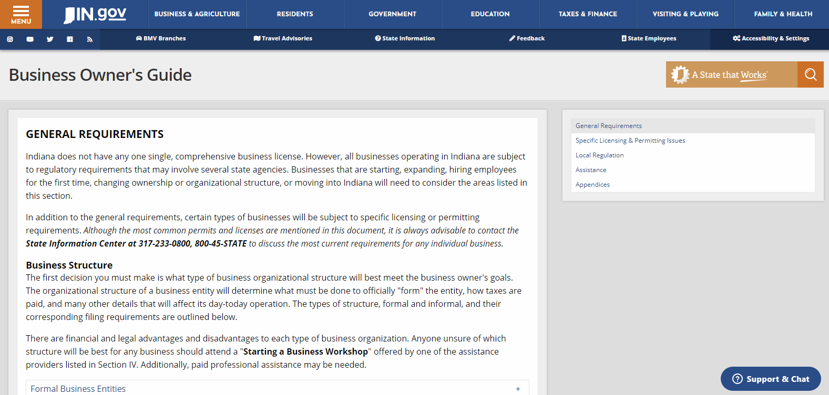
Go to the IN.Gov
https://www.in.gov/core/business_guide.html
The Business Owner’s Guide provides great information on how to set up your business properly.
Notes:
The state website has all the information you need to set your business up correctly and how to operate it the right way.
The site is www.IN.Gov. When you go to the site there’s a tab at the top that says Business & Agriculture. When you click on that a panel pops up and you can click on business. When you do that a panel on the left has some tabs and when you click on the one that says business owner’s guide to State Government, this page comes up. The shortcut is to go to https://www.in.gov/core/business_guide.html
This page provides great information on how to set up your business the right way.

Slide 10
Go to the IN.Gov
https://www.in.gov/core/business_guide.html
The Business Owner’s Guide provides great information on how to set up your business properly.
Notes:
It tells you about Formal Entities
Less formal entities
Non-profit entities
Federal tax information
State tax information
Unemployment insurance
Worker’s compensation
Labor
New Hire reporting
And posting requirements.

Slide 11
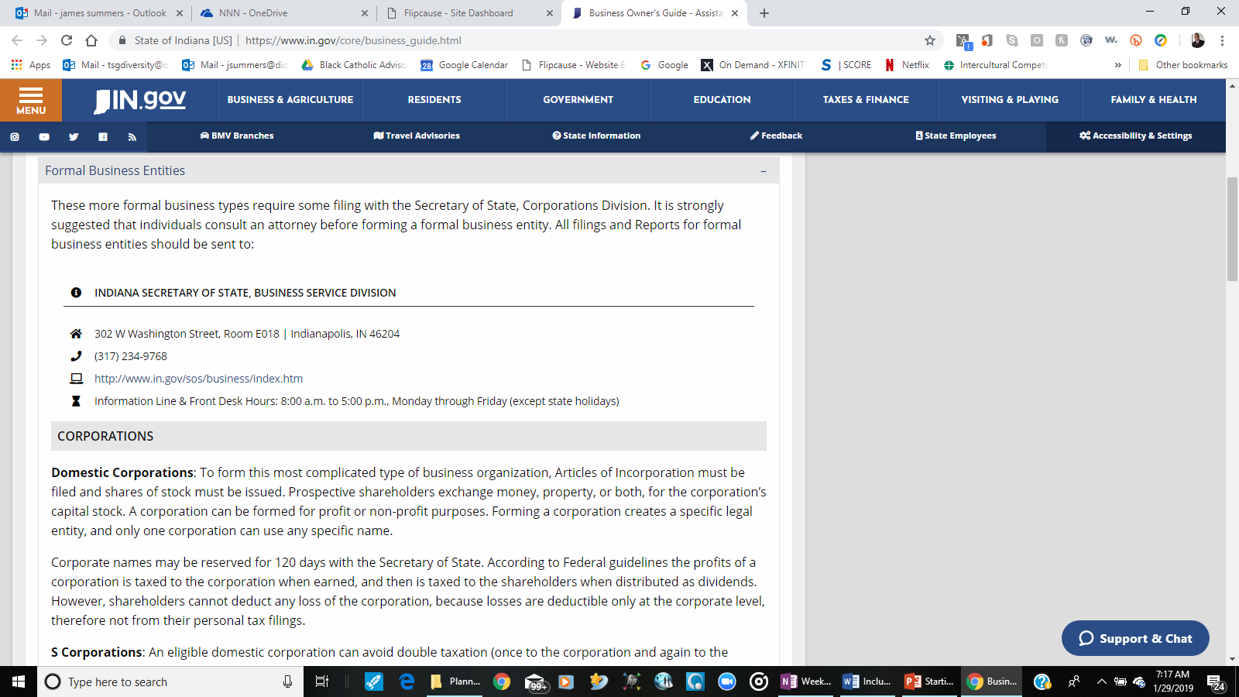
Formal Business
Entities
Domestic Corporations
S Corporations
Foreign Corporations
All Corporations
Notes:
Domestic Corporations: This is the most complicated type of business organization. You have to file Articles of Incorporation and shares of stock have to be issued. Prospective shareholders exchange money, property, or both, for the corporation’s capital stock. A corporation can be formed for profit or non-profit purposes. Forming a corporation creates a specific legal entity, and only one corporation can use any specific name.
Corporate names may be reserved for 120 days with the Secretary of State. According to Federal guidelines the profits of a corporation is taxed to the corporation when earned, and then is taxed to the shareholders when distributed as dividends. However, shareholders cannot deduct any loss of the corporation, because losses are deductible only at the corporate level, therefore not from their personal tax filings.
S Corporations: An eligible domestic corporation can avoid double taxation (once to the corporation and again to the shareholders) by electing to be treated as an S corporation. This is a separate legal and taxable entity, and can have no more than 100 owners. Generally, an S Corp is exempt from federal income tax other than tax on certain capital gains and passive income. An additional requirement is a Federal Employer Identification (EIN). Further, according to federal guidelines, in order to obtain SCorporation status the federal form 2553 is required to be filed with the IRS.
A Corporation doing business in a name other than the name listed on the Articles of Incorporation must file a Certificate of Assumed Business Name with the County Recorder and the Office of the Secretary of State.
All types of corporations, business corporations, professional corporations, C Corporations, and Subchapter S Corporations have essentially the same filing requirements. They may have different tax responsibilities, but they are still corporations. Professional corporations will be required to file a certificate of registration showing that the professional is licensed in Indiana.
By definition, corporations usually have employees, even if those employees own all of the stock. Therefore, forming a corporation will entail that you cover the issues outlined in Section I-C Additional Employer Responsibilities.
Foreign Corporations: If a business is already incorporated in another state and is "doing business" in Indiana as defined by the Indiana Code, then it must obtain a Certificate of Authority from the Secretary of State to do business in Indiana as a foreign corporation.
All Corporations: Beginning January 1, 1997, all domestic and foreign business entities except for nonprofit corporations and limited partnerships are required to file biennial reports. A business entity must file a biennial report two years after the initial corporation filing has been completed, even if no business is being conducted.
The report must be filed with the Secretary of State by the end of the month in which the entity was incorporated, every second year following the year of incorporation. (If incorporated in even year, the Report is filed every even year. If incorporated in odd year, the report is filed every odd year.) The filing fee for these biennial filings is $30.00. Non-profit corporations file annual reports with a $10.00 filing fee.

Slide 12
Unincorporated
Entities
Limited Liability Partnership
Limited Partnership
Limited Liability Company
Notes:
Limited Liability Partnerships, Limited Liability Companies, and Limited Partnerships are unincorporated entities, but they are still formally organized entities. Here’s a brief description
Limited Liability Partnership: A hybrid form of a general partnership. In general, liabilities are limited.
Limited Partnership: A form of partnership in which liabilities are limited to general partners, while limited partners’ liability is limited to their agreed investment in the business.
Limited Liability Company: A limited liability company (LLC) is an entity formed under state law by filing articles of organization as n LLC. None of the member of an LLC are personally liable for its debts. AN LLC may be classified for federal income tax purposes as a partnership, a corporation, or an entity dis-regarded as an entity separate from its owner by applying the rules in federal regulations section 301.7701.3.
A Limited Liability Company must file (State Form 49459) from the Secretary of States Office to establish articles of organization. There are no specific forms to be filed to create the other entities listed, but certain information is required by law to be filed with the Secretary of State's Office. Forms for these entities are commonly created by attorneys. Limited Liability Partnerships and Limited Liability Companies are required to file biennial reports as described for corporations, but Limited Partnerships have no yearly filing requirements.
Limited Liability Partnerships, Limited Liability Companies, and Limited Partnerships which are based outside of Indiana will need to file a Certificate of authority to do business in Indiana, similar to what foreign corporations file. (There is no established state form for this.) Likewise, is these entities are doing business in a name other than the one filed with the Secretary of State's Office, they will need to file a Certificate of Assumed Business Name with the Secretary of State and County Recorder as well.

Slide 13
Less Formal
Entities
Sole Proprietorship
General Partnership
Non-Profit entities
Notes:
Less formal organizations do not require filings with state government to come into existence. If, however, the business name does not contain the owner's (owners') name(s), it must be recorded with the Recorder of the county in which the business is located. Registration of a business name does not protect the name from being used by another business. Form: Provided by County Recorder, created by an attorney, or use generic format shown in Appendix A.
SOLE PROPRIETORSHIP
This type of business entity has a single owner, with no exemptions he/she is liable for all debts incurred. The owner and the business is one single entity. The owner is personally liable for anything that happens with the business. Income and expenses of the business on their personal tax return. It is the simplest form of business organization to start and maintain. Its liabilities are the owner’s personal liabilities.
Federal and State income taxes are reported on the proprietor's (owner's) individual income tax return as self-employment taxes. The profits of the business are taxed to the owner on his/her 1040 Schedule (federal) annually, and the income is taxed only once.
GENERAL PARTNERSHIP
Partnerships have two or more owners who both contribute money, labor and skills. The partners are jointly and severally liable for debts and share proportionately in profits. Income and expenses of the business are filed on the partnership return (Form IT-65), and income taxes are reported on individual tax returns. In general, partnerships function like sole proprietorships with more than one owner.
A partnership must file and annual information return to report the income deductions, gains, loses, etc., from its operations, but it does not pay income tax. Instead, it passes through any profits or losses to its partners. Each partner includes his/her share of the partnership’s items on his/her federal tax return.
Non-Profit entities can be organized formally or informally, but it is important to know the tax-related requirements before setting up the entity. Otherwise, the company may have to dissolve itself and reorganize to comply with rules to obtain the tax status it needs to operate. Contact the Indiana Department of Revenue for state requirements to obtain a not-for-profit tax registration certificate and the IRS for federal requirements to obtain non-profit (commonly known as 501(c)(3)) status. The IRS publishes an information booklet entitled "Tax Exempt Status For Your Organization", publication #557 which is available upon request.

Slide 14
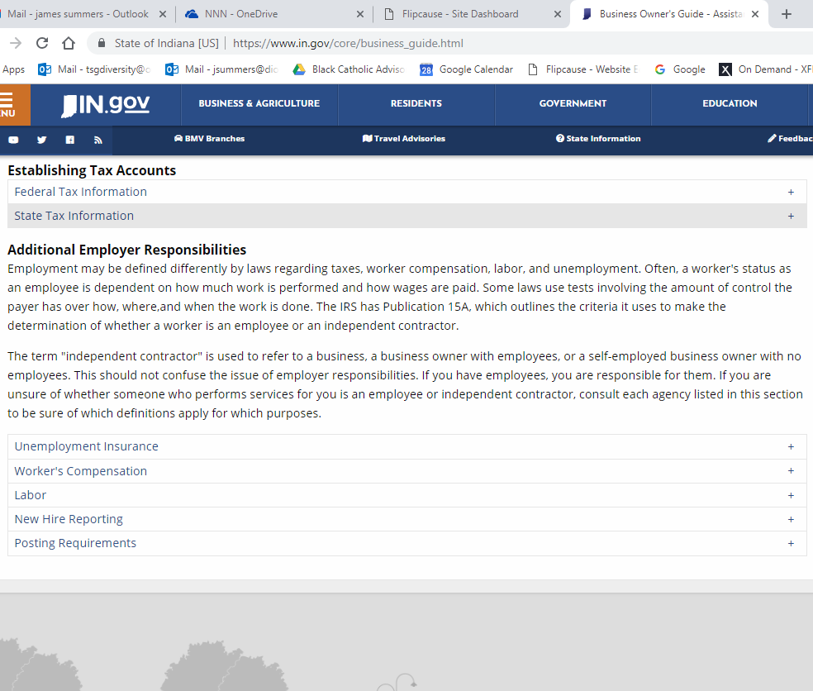
Federal Tax
Information
You must have an Employer Identification Number (EIN)
if you have employees,
have a qualified retirement plan, operate your business as a corporation or partnership,
or file employment taxes, or excise taxes.
Notes:
Any business with employees must have an Employer Identification Number (EIN) which identifies the tax accounts of employers, corporations, partnerships, limited liability companies with more than one owner, estates, trusts and other entities. Under federal guidelines, you also need an EIN if you have a qualified retirement plan, operate your business as a corporation or partnership, or file employment taxes, or excise taxes.
You should have only one EIN. To obtain an EIN, call the Internal Revenue Service for Form SS-4. Complete the form, and then either mail the form to the IRS, or call to receive your number. Business owners may also be required to file self employment taxes quarterly. Contact the IRS for its publications 533 and 509 on self-employment taxes. If the business does not have employees and does not expect to have any, the IRS may not allow the business to obtain an EIN. In such a case, the business owner's social security number is used as the Federal Tax Identification Number.

Slide 15
State Tax
Information
Any individual or business entity engaged in the selling or transferring of tangible personal property is considered a retail merchant and is required to be registered as such with the Indiana Department of Revenue.
Notes:
REGISTRATION FOR SALES, USE, AND INCOME TAXES
How to Register: A single application (Form BT-1) is used to register with the Indiana Department of Revenue for sales tax, withholding tax, food & beverage tax, county innkeeper tax, motor vehicle rental excise tax, and prepaid sales tax on gasoline. A separate application is required for each business location. There is a $25.00 non refundable application fee for a Retail Merchants Certificate. BT1/Business Tax Application: www.in.gov/dor (On line Services).
Sales Tax - Retail Merchants Certificate: Any individual or business entity engaged in the selling or transferring of tangible personal property is considered a retail merchant and is required to be registered as such (by filing Form BT-1) with the Indiana Department of Revenue. Registering as a retail merchant accomplishes what people commonly refer to as "getting a tax ID number" or "getting a tax-exempt number." The information regarding sales and use taxes should be read carefully, keeping in mind that taxes cannot be avoided on items which will not be resold.
Once registered as a retail merchant, the Department of Revenue will assign a tax identification number and will issue the appropriate Sales Tax Returns (ST103). The Department will also determine the business' filing status based upon anticipated sales. For additional information regarding sales or use taxes, contact the main office listed here or see one of the regional offices listed in Appendix C.

Slide 16
Additional
Responsibilities
"independent contractor" is used to refer to a business, a business owner with employees, or a self-employed business owner with no employees.
Notes:
Additional Employer Responsibilities
Employment may be defined differently by laws regarding taxes, worker compensation, labor, and unemployment. Often, a worker's status as an employee is dependent on how much work is performed and how wages are paid. Some laws use tests involving the amount of control the payer has over how, where,and when the work is done. The IRS has Publication 15A, which outlines the criteria it uses to make the determination of whether a worker is an employee or an independent contractor.
The term "independent contractor" is used to refer to a business, a business owner with employees, or a self-employed business owner with no employees. This should not confuse the issue of employer responsibilities. If you have employees, you are responsible for them. If you are unsure of whether someone who performs services for you is an employee or independent contractor, consult each agency listed in this section to be sure of which definitions apply for which purposes

Slide 17
Register with DWD 1st liable for premiums
If you have a State Unemployment Tax Act (SUTA) Account
Need FEIN number
Submit on or before 1st quarterly report
Unemployment
Insurance
Notes:
Employer Registration If you are an employer, you must register with DWD during the first quarter you are liable to pay premiums. You can register online using our online Uplink Employer Self Service program, at https://uplink.in.gov/ESS/ESSLogon.htm. The Uplink Employer Self Service System gives you immediate access to services and information online 24 hours a day, 7 days a week.
Uplink Employer Self Service allows you to do the following online:
Register as a new employer
Review and maintain unemployment insurance account information
Submit quarterly unemployment insurance contribution reports
Make payments by e-check and credit card (certain fees apply)
If you are an employer with an existing SUTA account number be sure to check the ‘Yes’ option button on the first screen after clicking ‘New User’ on the Employer Self Service logon screen. To register an existing account, you will need your FEIN number, your SUTA number, and the total gross wages from your last quarter.
You may also register by completing State Form 2837 (Report to Determine Status), which is located at www.in.gov/dwd/2406.htm or call DWD at (800) 437-9136 and request the form be mailed to you. Employee registration should be submitted on-line at https://uplink.in.gov/ESS/ESSLogon.htm on or before the due date of the employer’s first quarterly report.

Slide 18
Obtain from private insurance carrier
Required to apply for certification of independent contractor status
Must certify has worker's compensation coverage for all employees
Seven (7) day waiting period before a certificate can be validated
$20 fee
Worker’s
Compensation
Notes:
All Indiana employers must obtain worker's compensation from a private insurance carrier. If an injury to an employee occurs and results in more than one day away from work, the employer must electronically file an Indiana Worker's Compensation First Report of Employee Injury, Illness.
Certification of Independent Contractor Status and Worker's Compensation Exemption: Independent contractors in the construction and building trade are required to apply to the Indiana Department of Revenue for certification of independent contractor status. Clearance must first be received from the Department of Revenue before the Worker's Compensation Board may process an application for exemption.
The independent contractor must certify that he or she has worker's compensation coverage for all employees in accordance with IC 22-3-2 through IC 22-3-6 and that the independent contractor desires to be exempt from being able to recover under the worker's compensation policy or self-insurance of an individual for whom the independent contractor will perform work only as an independent contractor. There is a seven (7) day waiting period before a certificate can be validated. The fee for each certificate is $20

Slide 19
Indiana Occupational Safety and Health Act (IOSHA)
Division of INSAFE
Child Labor Laws
Age Discrimination
Minimum Wage
Wage Payment
Labor
Notes:
LaborInformation regarding any Indiana labor laws can be obtained by calling the individual numbers listed with each area, or by contacting:
INDIANA DEPARTMENT OF LABOR
402 W. Washington Street Room W195 | Indianapolis, IN 46204
(317) 232-2655
http://www.in.gov/dol
INDIANA OCCUPATIONAL SAFETY AND HEALTH ACT (IOSHA)
The Indiana Department of Labor, IOSHA Division, is the sole compliance agency for occupational safety and health standards in the State of Indiana. The ultimate goal of IOSHA is the elimination of occupational injury, disease, and illness among Indiana workers. There are general industry standards that apply to any employer.
Some specific industries have their own standards as well. Additionally, employees may not suffer dismissal or discrimination for making known a concern about workplace health or safety. For more information, contact IOSHA at (317) 232-2693.
DIVISION OF INSAFE
INSafe’s primary function is to aid businesses with voluntary compliance with IOSHA standards and to develop comprehensive safety and health programs through safety education and training. This is most effectively accomplished through on-site consultative visits, which are free and available to any business upon written request. The on-site consultation program assists employers in identifying and correcting safety and health hazards under a protective abatement program. INSafe offers technical assistance, recommendations for reducing or eliminating existing hazards and assessment of employer's safety and health programs. For more information, call (317) 232-2688.
CHILD LABOR LAWS
The Indiana Department of Labor's Bureau of Child Labor enforces the Indiana child labor laws, which apply to minors, ages 14 through 17 years. The Bureau oversees Employment Certificates, processes and acts on complaints of violations including, but not limited to, excessive hours, late hours, or hazardous occupations.
Generally, any minor between ages 14 and 17 years must obtain an Employment Certificate before beginning employment. Employment Certificates are issued by the School Corporation the minor attends. For more information regarding the employment of a minor, call (317) 232-2655.
AGE DISCRIMINATION
The Indiana Department of Labor's Employment Standards Division administers Indiana's Age Discrimination Act and investigates charges of age discrimination at state-covered businesses (generally, those employing fewer than 20 employees). For more information, call (317) 232-2655. Charges of age discrimination against employers of more than 20 must be filed with the Equal Employment Opportunity Commission (EEOC) at (800) 669-4000.
MINIMUM WAGE
The Employment Standards Division also administers the Indiana Minimum Wage Law, which applies to employers not subject to the Federal Fair Labor Standards Act. Indiana’s minimum wage was $6.25 per hour as of July 24, 2008. Following that on July 24, 2009 it raised to $7.25 per hour. For more information regarding state and federal minimum wage laws, call: (317) 232-2655.
WAGE PAYMENT
Employees who are not paid all wages earned on the regular payday for the period in which they are earned may file a wage claim with the Employment Standards Division. If a valid complaint cannot be resolved administratively, the file is referred to a private attorney for action, and penalties up to double the amount due, plus attorney's fees and court costs may be assessed against the employer. For additional information call (317) 232-2655.

Slide 20
Required to report all new and rehired employees within 20 days of hire under penalty of $500 fine.
Most of the posters have size requirements
At least one copy of each poster is free to any employer
New Hire & Posting
Notes:
Effective October 1, 1997, under Indiana State Statute IC22.4.1-4-2. and the Federal Personal Responsibility and Work Opportunity Reconciliation Act of 1996 (PRWORA) all public, private, nonprofit, and government employers were required to report all new and rehired employees within 20 days of hire to the Indiana New Hire Reporting Center. Failure to report a new employee could result in a fine of $500. Please see the following website: http://www.in-newhire.com or for questions call (866) 879-0198 or (317) 612-3036.
Many state and federal employment laws have corresponding posting requirements. Please keep in mind that most of the posters have size requirements included in state or federal law, and many of the "combined posters" sold by private companies do not meet these size requirements. At least one copy of each poster is free to any employer, and the contact information is listed below with each one or download posters http://www.in.gov/dwd/2455.htm.

Slide 21
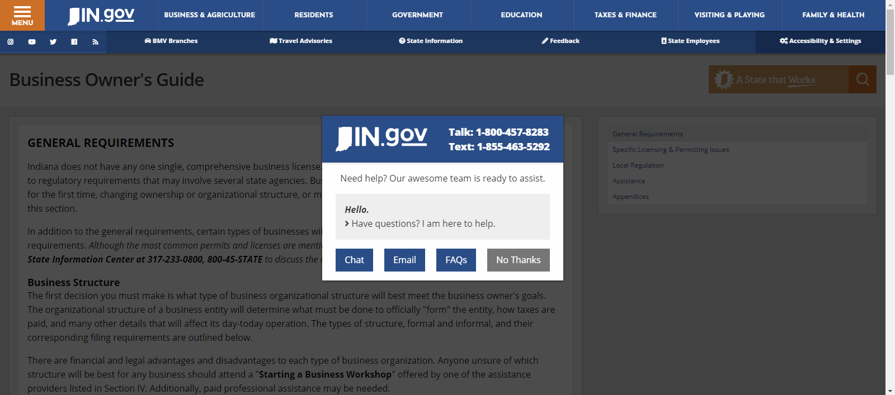
Note that you can get help from the site to walk you through and answer questions.
Notes:
One of the things that will happen is a pop up for you to get help from a chat, email, or Frequently asked question.

Slide 22
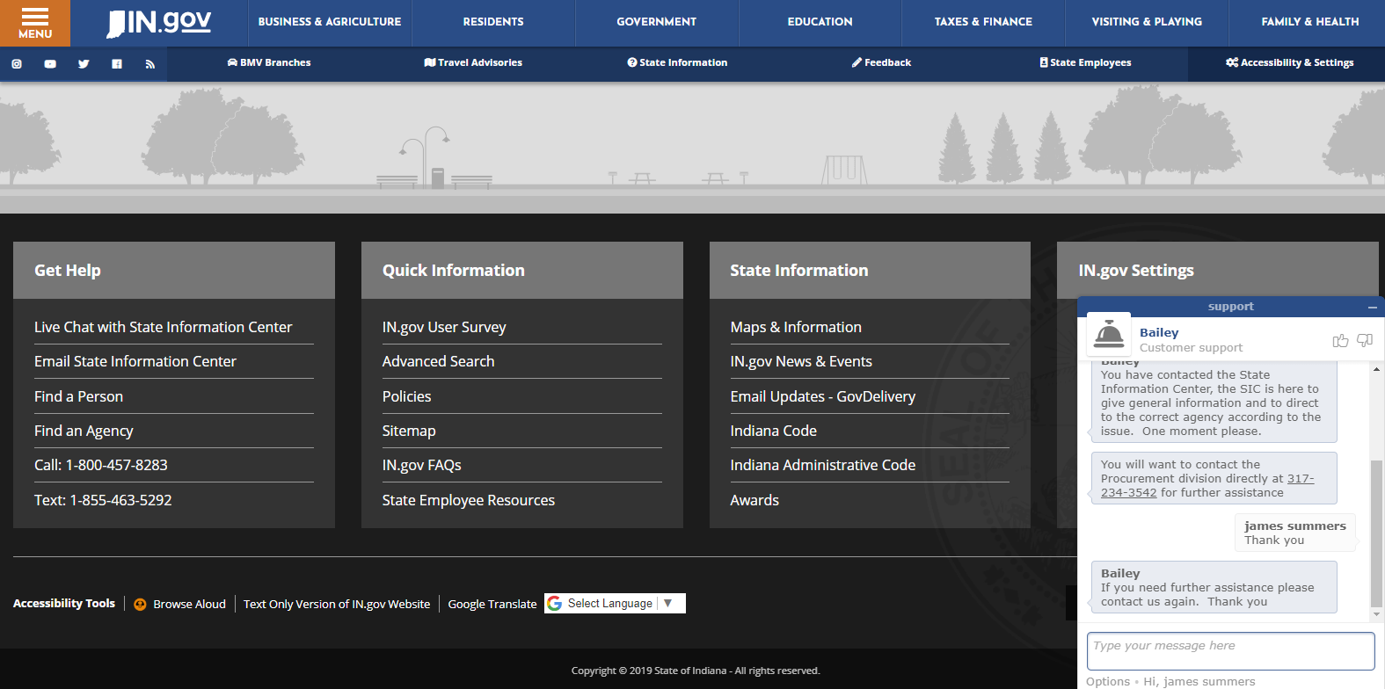
The chat will pop up like this and allow you to connect directly with a representative to answer your questions and direct you to the appropriate resource for specific questions
Notes:
The chat will pop up like this and allow you to connect directly with a representative to answer your questions and direct you to the appropriate resource for specific questions
[NOTE TIME CHECK. IT SHOULD BE ABOUT 6:30]

Slide 23
Creating a Business Plan for your company
Notes:
Creating a Business Plan for your Company

Slide 24
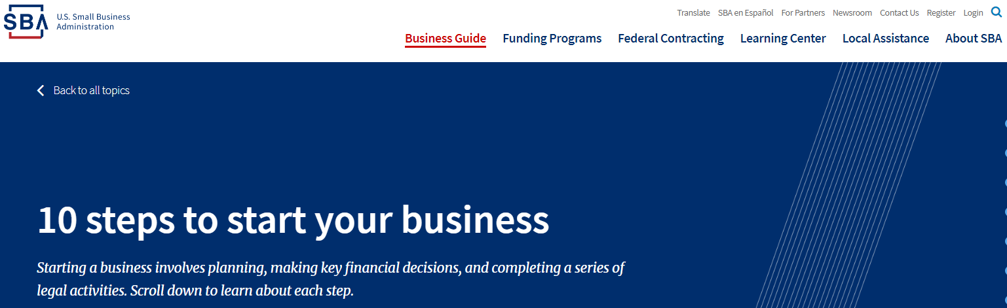
Go to 10 steps to start your business
https://www.sba.gov/business-guide/10-steps-start-your-business/
Conduct market research
Write your business plan
Fund your business
Pick your business location
Choose a business structure
Choose your business name
Register your business
Get federal and state tax IDs
Apply for licenses and permits
Open a business bank account
Notes:
1 Conduct market research
Market research will tell you if there’s an opportunity to turn your idea into a successful business. It’s a way to gather information about potential customers and businesses already operating in your area. Use that information to find a competitive advantage for your business.
2 Write your business plan
Your business plan is the foundation of your business. It’s a roadmap for how to structure, run, and grow your new business. You’ll use it to convince people that working with you — or investing in your company — is a smart choice.
3 Fund your business
Your business plan will help you figure out how much money you’ll need to start your business. If you don’t have that amount on hand, you’ll need to either raise or borrow the capital. Fortunately, there are more ways than ever to find the capital you need.
4 Pick your business location
Your business location is one of the most important decisions you’ll make. Whether you’re setting up a brick-and-mortar business or launching an online store, the choices you make could affect your taxes, legal requirements, and revenue.
5 Choose a business structure
The legal structure you choose for your business will impact your business registration requirements, how much you pay in taxes, and your personal liability.
6 Choose your business name
It’s not easy to pick the perfect name. You’ll want one that reflects your brand and captures your spirit. You’ll also want to make sure your business name isn’t already being used by someone else.
7 Register your business
Once you’ve picked the perfect business name, it’s time to make it legal and protect your brand. If you’re doing business under a name different than your own, you’ll need to register with the federal government, and maybe your state government, too.
8 Get federal and state tax IDs
You’ll use your employer identification number (EIN) for important steps to start and grow your business, like opening a bank account and paying taxes. It’s like a social security number for your business. Some — but not all — states require you to get a tax ID as well.
9 Apply for licenses and permits
Keep your business running smoothly by staying legally compliant. The licenses and permits you need for your business will vary by industry, state, location, and other factors.
10 Open a business bank account
A small business checking account can help you handle legal, tax, and day-to-day issues. The good news is it’s easy to set one up if you have the right registrations and paperwork ready.

Slide 25
Market research helps you find customers for your business. Competitive analysis helps you make your business unique. Combine them to find a competitive advantage for your small business.
Use market research to find customers
Use competitive analysis to find a market advantage
Free small business data and trends: See examples
Notes:
Use market research to find customers
Market research blends consumer behavior and economic trends to confirm and improve your business idea.
It’s crucial to understand your consumer base from the outset. Market research lets you reduce risks even while your business is still just a gleam in your eye.
Gather demographic information to better understand opportunities and limitations for gaining customers. This could include population data on age, wealth, family, interests, or anything else that’s relevant for your business.
Then answer these questions to get a good sense of your market.
Demand: Is there a desire for your product or service?
Market size: How many people would be interested in your offering?
Economic indicators: What is the income range and employment rate?
Location: Where do your customers live and where can your business reach?
Market saturation: How many similar options are already available to consumers?
Pricing: What do potential customers pay for these alternatives?
You’ll also want to keep up with the latest small business trends. It’s important to gain a sense of the specific market share that will impact your profits.
You can do market research using existing sources, or you can do the research yourself and go direct to consumers.
Existing sources can save you a lot of time and energy, but the information might not be as specific to your audience as you’d like. Use it to answer questions that are both general and quantifiable, like industry trends, demographics, and household incomes. Check online or start with our list of market research resources.
Asking consumers yourself can give you a nuanced understanding of your specific target audience. But, direct research can be time consuming and expensive. Use it to answer questions about your specific business or customers, like reactions to your logo, improvements you could make to buying experience, and where customers might go instead of your business.
Here are a few methods you can use to do direct research:
Surveys
Questionnaires
Focus groups
In-depth interviews
For guidance on deciding which methods are worthwhile for your small business, the Small Business Administration provides counseling services through our resource partner network.
Use competitive analysis to find a market advantage
Competitive analysis helps you learn from businesses competing for your potential customers. This is key to defining a competitive edge that creates sustainable revenue.
Your competitive analysis should identify your competition by product line or service and market segment. Assess the following characteristics of the competitive landscape:
Market share
Strengths and weaknesses
Your window of opportunity to enter the market
The importance of your target market to your competitors
Any barriers that may hinder you as you enter the market
Indirect or secondary competitors who may impact your success
The SizeUp tool helps small business owners discover how their business stacks up against competitors by city and industry. It’s a market analysis tool you can use to:
Create benchmarks against existing businesses
Map where competitors, customers, and suppliers are located
Find the best places to advertise
Several industries might be competing to serve the same market you’re targeting. That’s why you should make sure to differentiate your competitive analysis by industry. There are many methods for doing this, including Porter’s Five Forces analysis. Important industry factors to consider include level of competition, threat of new competitors or services, and the effect of suppliers and customers on price.

Slide 26
Your business plan is the foundation of your business. Learn how to write a business plan quickly and efficiently with a business plan template.
Business plans help you run your business
Pick a business plan format that works for you
Traditional business plan format
Lean startup format
Notes:
Business plans help you run your business
A good business plan guides you through each stage of starting and managing your business. You’ll use your business plan as a roadmap for how to structure, run, and grow your new business. It’s a way to think through the key elements of your business.
Business plans can help you get funding or bring on new business partners. Investors want to feel confident they’ll see a return on their investment. Your business plan is the tool you’ll use to convince people that working with you — or investing in your company — is a smart choice.
Pick a business plan format that works for you
There’s no right or wrong way to write a business plan. What’s important is that your plan meets your needs.
Most business plans fall into one of two common categories: traditional or lean startup.
Traditional business plans are more common, use a standard structure, and encourage you to go into detail in each section. They tend to require more work upfront and can be dozens of pages long.
Lean startup business plans are less common but still use a standard structure. They focus on summarizing only the most important points of the key elements of your plan. They can take as little as one hour to make and are typically only one page.
Traditional business plan format
You might prefer a traditional business plan format if you’re very detail oriented, want a comprehensive plan, or plan to request financing from traditional sources.
When you write your business plan, you don’t have to stick to the exact business plan outline. Instead, use the sections that make the most sense for your business and your needs. Traditional business plans use some combination of these nine sections.
Executive summary
Briefly tell your reader what your company is and why it will be successful. Include your mission statement, your product or service, and basic information about your company’s leadership team, employees, and location. You should also include financial information and high-level growth plans if you plan to ask for financing.
Company description
Use your company description to provide detailed information about your company. Go into detail about the problems your business solves. Be specific, and list out the consumers, organization, or businesses your company plans to serve.
Explain the competitive advantages that will make your business a success. Are there experts on your team? Have you found the perfect location for your store? Your company description is the place to boast about your strengths.
Market analysis
You'll need a good understanding of your industry outlook and target market. Competitive research will show you what other businesses are doing and what their strengths are. In your market research, look for trends and themes. What do successful competitors do? Why does it work? Can you do it better? Now's the time to answer these questions.
Organization and management
Tell your reader how your company will be structured and who will run it.
Describe the legal structure of your business. State whether you have or intend to incorporate your business as a C or an S corporation, form a general or limited partnership, or if you're a sole proprietor or LLC.
Use an organizational chart to lay out who's in charge of what in your company. Show how each person's unique experience will contribute to the success of your venture. Consider including resumes and CVs of key members of your team.
Service or product line
Describe what you sell or what service you offer. Explain how it benefits your customers and what the product lifecycle looks like. Share your plans for intellectual property, like copyright or patent filings. If you're doing research and development for your service or product, explain it in detail.
Marketing and sales
There's no single way to approach a marketing strategy. Your strategy should evolve and change to fit your unique needs.
Your goal in this section is to describe how you'll attract and retain customers. You'll also describe how a sale will actually happen. You'll refer to this section later when you make financial projections, so make sure to thoroughly describe your complete marketing and sales strategies.
Funding request
If you're asking for funding, this is where you'll outline your funding requirements. Your goal is to clearly explain how much funding you’ll need over the next five years and what you'll use it for.
Specify whether you want debt or equity, the terms you'd like applied, and the length of time your request will cover. Give a detailed description of how you'll use your funds. Specify if you need funds to buy equipment or materials, pay salaries, or cover specific bills until revenue increases. Always include a description of your future strategic financial plans, like paying off debt or selling your business.
Financial projections
Supplement your funding request with financial projections. Your goal is to convince the reader that your business is stable and will be a financial success.
If your business is already established, include income statements, balance sheets, and cash flow statements for the last three to five years. If you have other collateral you could put against a loan, make sure to list it now.
Provide a prospective financial outlook for the next five years. Include forecasted income statements, balance sheets, cash flow statements, and capital expenditure budgets. For the first year, be even more specific and use quarterly — or even monthly — projections. Make sure to clearly explain your projections, and match them to your funding requests.
This is a great place to use graphs and charts to tell the financial story of your business.
Appendix
Use your appendix to provide supporting documents or other materials were specially requested. Common items to include are credit histories, resumes, product pictures, letters of reference, licenses, permits, or patents, legal documents, permits, and other contracts.
Example traditional business plans
Before you write your business plan, read these example business plans written by fictional business owners. Rebecca owns a consulting firm, and Andrew owns a toy company.
Example business plans
Before you write your business plan, read these example business plans written by fictional business owners. Rebecca owns a consulting firm, and Andrew owns a toy company.
Lean startup format
You might prefer a lean startup format if you want to explain or start your business quickly, your business is relatively simple, or you plan to regularly change and refine your business plan.
Lean startup formats are charts that use only a handful of elements to describe your company’s value proposition, infrastructure, customers, and finances. They’re useful for visualizing tradeoffs and fundamental facts about your company.
There are many versions of lean startup templates, but one of the oldest and most well known is the Business Model Canvas, developed by Alex Osterwalder. You can search the web to find free templates of the Business Model Canvas, or other versions, to build your business plan.
We’ll discuss the nine components of the Business Model Canvas version here.
Key partnerships
Note the other businesses or services you’ll work with to run your business. Think about suppliers, manufacturers, subcontractors and similar strategic partners.
Key activities
List the ways your business will gain a competitive advantage. Highlight things like selling direct to consumers, or using technology to tap into the sharing economy.
Key resources
List any resource you’ll leverage to create value for your customer. Your most important assets could include staff, capital, or intellectual property. Don’t forget to leverage business resources that might be available to women, veterans, Native Americans, and HUBZone businesses.
Value proposition
Make a clear and compelling statement about the unique value your company brings to the market.
Customer relationships
Describe how customers will interact with your business. Is it automated or personal? In person or online? Think through the customer experience from start to finish.
Customer segments
Be specific when you name your target market. Your business won’t be for everybody, so it’s important to have a clear sense of who your business will serve.
Channels
List the most important ways you’ll talk to your customers. Most businesses use a mix of channels and optimize them over time.
Cost structure
Will your company focus on reducing cost or maximizing value? Define your strategy, then list the most significant costs you’ll face pursuing it.
Revenue streams
Explain how your company will actually make money. Some examples are direct sales, memberships fees, and selling advertising space. If your company has multiple revenue streams, list them all.
Example lean business plan
Before you write your business plan, read this example business plan written by a fictional business owner, Andrew, who owns a toy company.

Slide 27
What is a Business Plan and why do I need one?

Slide 28
So how do I create a plan for my business?

Slide 29
Calculate your business startup costs before you launch
Identify your startup expenses
Estimate how much your expenses will cost
Add up your expenses for a full financial picture
Use your startup cost calculations to get startup funding
How much money will it take to start your small business? Calculate the startup costs for your small business so you can request funding, attract investors, and estimate when you’ll turn a profit.
Notes:
Calculate your business startup costs before you launch
The key to a successful business is preparation. Before your business opens its doors, you’ll have bills to pay. Understanding your expenses will help you launch successfully.
Calculating startup costs helps you:
Estimate profits
Do a breakeven analysis
Secure loans
Attract investors
Save money with tax deductions
Identify your startup expenses
Most businesses fall into one of three categories: brick-and-mortar businesses, online businesses, and service providers. You’ll face different startup expenses depending on your business type.
There are common startup costs you’re likely to have no matter what. Look through this list, and make sure to add any other expenses that are unique to your business.
Office space
Equipment and supplies
Communications
Utilities
Licenses and permits
Insurance
Lawyer and accountant
Inventory
Employee salaries
Advertising and marketing
Market research
Printed marketing materials
Making a website
Estimate how much your expenses will cost
Once you have your list of expenses, you can estimate how much they’ll actually cost. This process will be different for each expense you have.
Some expenses will have well-defined costs — permits and licenses tend to have clear, published costs. You might have to estimate other costs that are less certain, like employee salaries. Look online and talk directly to mentors, vendors, and service providers to see what similar companies pay for expenses.
Add up your expenses for a full financial picture
Once you’ve identified your business expenses and how much they’ll cost, you should organize your expenses into one-time expenses and monthly expenses.
One-time expenses are the initial costs needed to start the business. Buying major equipment, hiring a logo designer, and paying for permits, licenses, and fees are generally considered to be one-time expenses. You can typically deduct one-time expenses for tax purposes, which can save you money on the amount of taxes you’ll owe. Make sure to keep track of your expenses and talk to your accountant when it’s time to file your taxes.
Monthly expenses typically include things like salaries, rent, and utility bills. You’ll want to count at least one year of monthly expenses, but counting five years is ideal.
Add up your one-time and monthly expenses to get a good picture of how much capital you’ll need and when you’ll need it.
Use your startup cost calculations to get startup funding
It’s a good idea to create a formal report of your expected startup costs.
You want it in a format that’s clear and easy to understand. Investors and lenders compare expected costs to projected revenue and determine the potential for your business to profit.

Slide 30
Determine how much funding you'll need
Fund your business yourself with self-funding
Get venture capital from investors
Use crowdfunding to fund your business
Get a small business loan
Use Lender Match to find lenders who offer SBA-guaranteed loans
Small Business Administration investment programs
It costs money to start a business. Funding your business is one of the first — and most important — financial choices most business owners make. How you choose to fund your business could affect how you structure and run your business.
Notes:
Determine how much funding you'll need
Every business has different needs, and no financial solution is one size fits all. Your personal financial situation and vision for your business will shape the financial future of your business.
Once you know how much startup funding you’ll need, it’s time to figure out how you’ll get it.
Fund your business yourself with self-funding
Otherwise known as bootstrapping, self-funding lets you leverage your own financial resources to support your business. Self-funding can come in the form of turning to family and friends for capital, using your savings accounts, or even tapping into your 401k.
With self-funding, you retain complete control over the business but you also take on all the risk yourself. Be careful not to spend more than you can afford, and be especially careful if you choose to use tap into retirement accounts early. You might face expensive fees or penalties, or damage your ability to retire on time — so you should check with your plan’s administrator and a personal financial advisor first.
Get venture capital from investors
Investors can give you funding to start your business in the form of venture capital investments. Venture capital is normally offered in exchange for an ownership share and active role in the company.
Venture capital differs from traditional financing in a number of important ways. Venture capital typically:
Focuses high-growth companies
Invests capital in return for equity, rather than debt (it’s not a loan)
Takes higher risks in exchange for potential higher returns
Has a longer investment horizon than traditional financing
Almost all venture capitalists will, at a minimum, want a seat on the board of directors. So be prepared to give up some portion of both control and ownership of your company in exchange for funding.
How to get venture capital funding
There’s no guaranteed way to get venture capital, but the process generally follows a standard order of basic steps.
Find an investor Look for individual investors — sometimes called “angel investors” — or venture capital firms. Be sure to do enough background research to know if the investor is reputable and has experience working with startup companies.
Share your business plan The investor will review your business plan to make sure it meets their investing criteria. Most investment funds concentrate on an industry, geographic area, or stage of business development.
Go through due diligence review The investors will look at your company’s management team, market, products and services, corporate governance documents, and financial statements.
Work out the terms If they want to invest, the next step is to agree on a term sheet that describes the terms and conditions for the fund to make an investment.
Investment Once you agree on a term sheet, you can get the investment! Once a venture fund has invested, it becomes actively involved in the company. Venture funds normally come in “rounds.” As the company meets milestones, further rounds of financing are made available, with adjustments in price as the company executes its plan.
Use crowdfunding to fund your business
Crowdfunding raises funds for a business from a large number of people, called crowdfunders. Crowdfunders aren’t technically investors, because they don’t receive a share of ownership in the business and don’t expect a financial return on their money.
Instead, crowdfunders expect to get a “gift” from your company as thanks for their contribution. Often, that gift is the product you plan to sell or other special perks, like meeting the business owner or getting their name in the credits. This makes crowdfunding a popular option for people who want to produce creative works (like a documentary), or a physical product (like a high-tech cooler).
Crowdfunding is also popular because it’s very low risk for business owners. Not only do you get to retain full control of your company, but if your plan fails, you’re typically under no obligation to repay your crowdfunders. Every crowdfunding platform is different, so make sure to read the fine print and understand your full financial and legal obligations.
Get a small business loan
If you want to retain complete control of your business, but don’t have enough funds to start, consider a small business loan.
To increase your chances of securing a loan, you should have a business plan, expense sheet, and financial projections for the next five years. These tools will give you an idea of how much you'll need to ask for, and will help the bank know they’re making a smart choice by giving you a loan.
Once you have your materials ready, contact banks and credit unions to request a loan. You’ll want to compare offers to get the best possible terms for your loan.
Use Lender Match to find lenders who offer SBA-guaranteed loans
If you have trouble getting a traditional business loan, you should look into SBA-guaranteed loans. When a bank thinks your business is too risky to lend money to, the SBA can agree to guarantee your loan. That way, the bank has less risk and is more willing to give your business a loan.
Use Lender Match to find lenders who offer SBA-guaranteed loans.
Small Business Administration investment programs
Small Business Investment Company (SBIC)
SBICs are privately owned and managed investment funds licensed and regulated by the Small Business Administration. They use their own capital, plus funds borrowed with an SBA guarantee, to make equity and debt investments in qualifying small businesses. Learn more about SBICs to see if your business might qualify.
Small Business Innovation Research (SBIR) program
This program encourages small businesses to engage in federal research and development that has the potential for commercialization. Find out if the SBIR’s competitive awards-based program makes sense for you.
Small Business Technology Transfer (STTR) program
This program offers funding opportunities in the federal innovation research and development arena. Small businesses who qualify for this program work with nonprofit research institutions in the early and intermediate stages of starting up. Find out if the STTR program makes sense for your business.

Slide 31
Know the difference between franchising and buying a business
Consider 3 factors before franchising or buying a business
Get ready to buy your franchise or business
It can be hard to start a business from scratch. Starting a business from scratch can be challenging. The good news? You don’t have to start from scratch to have your own business. Consider franchising or buying an existing business.
Notes:
Know the difference between franchising and buying a business
Before you decide if one of these options is right for you, make sure you know the basics of franchising and buying an existing business. The main difference between franchising and buying an existing business is the level of control you’ll have over your business.
Franchising gives you more guidance but less control
A franchise is a business model where one business owner (the “franchisor”) sells the rights to their business logo, name, and model to an independent entrepreneur (the “franchisee”). Restaurants, hotels, and service-oriented businesses are commonly franchised.
Two common forms of franchising are:
Product/trade name franchising: The franchisor owns the right to the name or trademark of a business, and sells the right to use that name and trademark to a franchisee. This style of franchising normally focuses on supply chain management. Typically, products are manufactured or supplied by the franchisor and delivered to the franchisee to sell.
Business format franchising: The franchisor and franchisee have an ongoing relationship. This style of franchising normally focuses on full-spectrum business management. Typically, the franchisor offers services like site selection, training, product supply, marketing plans, and even help getting funding
When you buy a franchise, you get the right to use the name, logo, and products of a larger brand. You’ll also get to benefit from brand recognition, promotions, and marketing. But, it also means you have to follow rules from the larger brand about how you run your business.
Buying an existing business gives you more control but less guidance
Buying an existing business is exactly what it sounds like. The buyer typically takes over full ownership of the business. The largest advantage is having an existing blueprint that can include important factors like an established customer base, defined operating expenses, and fully trained employees. Regardless of business type, almost any kind of business could be bought or sold.
When you buy an existing business, you typically get complete control over its direction. However, with no set vision, infrastructure, or external guidance, your business could struggle as you figure out the best way to run things.
Consider 3 factors before franchising or buying a business
Though the business models differ, there are three common steps to take that will help you determine whether you should franchise or buy a business.
Quantify your investment: Review your financial landscape and decide how much you’re willing to spend to purchase — and ultimately manage — the business. This will help you determine what type of businesses or brands are best for your budget.
Consider your talents and lifestyle: Be honest about your skills and experience, as they can help you eliminate unrealistic business ventures. For example, if you prefer hands-on assistance, then franchising might be best for you. On the contrary, if you’re an experienced business owner, you may want to consider buying an existing business.
Review the full landscape: Look at the existing infrastructure and make sure you understand everything that comes along with the purchase. Don’t be afraid to ask questions about contracts, leases, existing cash flow, and inventory. The more you know, the better equipped you’ll be to make a sound decision.

Slide 32
Access to Resources and Information for your Business Plan from the Center
Align with opportunities
Adapt to change
Optimize performance
Meet with a SCORE mentor
Discuss goals and objectives
Design a plan
Monitor and measure results
Notes:
Through the CUC Business Development Centers you have access to SCORE mentors who can help you with your business plan. You can schedule an appointment with a center volunteer or online. You will be asked when you would like to meet and if at the Center or at the SCORE office. In preparation you will be asked to think about the following questions:
Who are your target customers and users?
What are the characteristics of your ideal customer?
What are the top 3 problems your business solves?
How are those problems being solved today?
What makes your business different, unique and important to the customer?
How does your business solve the problems you identified?
How do you connect with the customers you identified?
How does your business generate revenue?
What does it cost to run your business?
What are the key-metrics (numbers) that let you know how your business is doing?
What is special about your business that cannot be easily copied or bought?
You will be provided some basic tools for tracking your business in a spreadsheet, plugging your information into a business model canvas and from there into a business plan template. The materials provided are aligned with our partner BrightPoint so that you will be prepared to apply to leverage their Bright Launch Capital if desired.

Slide 33
Questions
WEEK Two: Project Delivery Systems and Contract Risk Management

Slide 34
Upcoming Events
Elevator pitch workshop TBD
Public Works Networking Event Feb 19
Lead abatement training March 4
Disparity Study Meeting March 20
How to select your Business Banker Workshop
How to select your Insurance Partner Workshop
How to select your Business Accountant Workshop
Notes:
Every year Public Works hosts an event to discuss upcoming contracting opportunities with potential contractors and vendors.
This year, by request, they have moved the date up to February 19, 2019.
The city has requested information on Center members to invite them to the event. We do not share your information without your permission, so if you wish us to share your contact information so that you can be invited, please let us know by email.
It will be an opportunity to meet one on one with primes who have done work for the City, and share their 5 minute elevator pitch for why they would be a great partner on a major project.
They should attend the event with
business cards,
1 page marketing flyers with pertinent information on what their company does,
testimonials from past clients,
bonding and insurance levels,
workforce plans (Affirmative Action Plans, Union affiliations, Section 3 Plans etc),
visuals of the scale and scope of work they’ve completed and
a short list of people primes can call to discuss evaluation of their past jobs.
On March 20 the Firm the city hired to do a disparity study will be here at the Center to speak to and listen to businesses to learn about barriers to growth in the community. They need to hear from you and others you know to include in their report. It’s also important that they know your businesses exist, otherwise the reason the opportunities aren’t made available is because the companies to take advantage of the opportunities don’t exist. I don’t know about you, but I don’t like being told I don’t exist. ☺

