Slide 1
WEEK Six: Doing Business with the City
Notes:
Welcome to our sixth Small Business Training Class. Thank you for joining us.

Slide 2
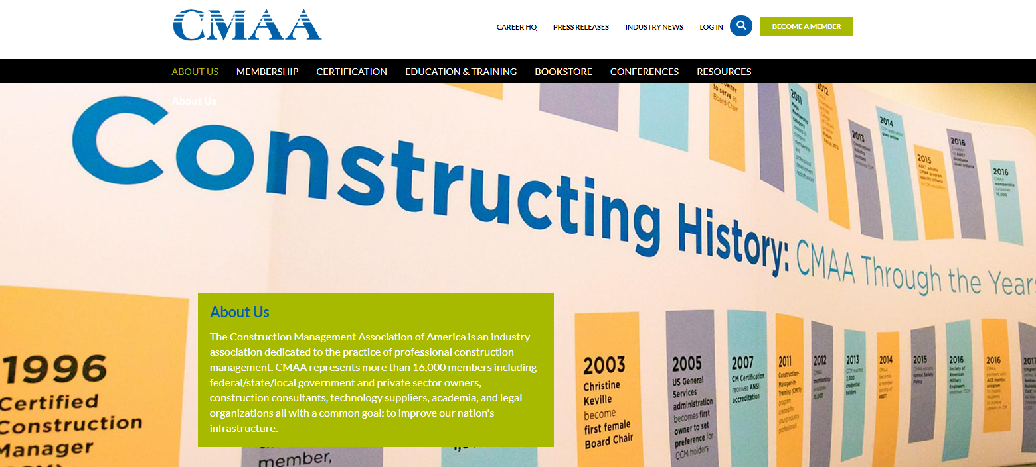
Last Week
Actions to be taken by Owners
Bid Inquiries
Pre-Bid Conference and Job Walk
Do Not Accept “Substantially Low” Bids
Best Value Selection Method
Validate BIM/VDC Skills
Status of Design
The Construction Management Association of America
https://www.cmaanet.org
Actions to be taken by Owners
Read the Contract
Do Not Underbid
Bid Exclusions, Assumptions and Clarifications
Use Subcontractors With Proven Capability
Do Not Subcontract Solely on Price For Specialty Work
Do Not Accept Unquantifiable Risks
Dispute Potential Index

Slide 3
Class PowerPoints
for download

Slide 4
Project Delivery Systems and
Contract Risk Management

Slide 5
Costs
Complete fee schedule
City Projects only
Determined by the amount of square footage
Electric, Plumbing, and HVAC are determined based on the specific categories
Notes:
The complete Fee Schedule can be found here.
For City Projects only, a Fire Department Plan Review Fee is required prior to the plans being reviewed. This fee is different for New Sprinkled Buildings, New Non-sprinkled Buildings, Additions, and remodels (the fire dept. plan review fee for remodels depends on the cost of labor and materials to complete code-related work for entire project).
Permit fees for projects constructing or demolishing square footage on a property are determined by the amount of square footage being added or demolished.
Structural permit fees for remodel projects that will not include constructing additional square footage are determined by the valuation of the job (cost of labor and materials to complete code-related work for entire project).
Permit fees for Electric, Plumbing, and HVAC are determined based on the specific categories of work being completed.

Slide 6
Eligibility
Contractors performing the construction
Copy of State Release must be provided
Commercial Building Project plans must be submitted to building department.
Notes:
The contractors that are performing the construction work are eligible to purchase a building permit.
If applicable, a copy of the State Release must be provided prior to permit issuance:
http://www.in.gov/dhs/3658.htm
Plans for Commercial Building Projects must be submitted to the Building Department for review. An application for Commercial Building Permit, including a list of sub-contractors, must be submitted prior to permit issuance. This is outlined in the permit application and supporting documents.

Slide 7
Eligibility
Contractors performing the construction
Copy of State Release must be provided
Commercial Building Project plans must be submitted to building department.

Slide 9
A GREAT DESTINATION FOR BUSINESS
ToolKit

Slide 10
How to select your business banker
What do you want to know?
What challenges do you anticipate?
What you need to provide?
Banker as your partner.
No second chance to make a first impression.

Slide 11
Questions
WEEK Five: Management

Slide 12
Upcoming Events
Elevator pitch workshop TBD
Public Works Networking Event Feb 19
Lead abatement training March 4
How to select your Business Banker Workshop March 19
Disparity Study Meeting March 20
How to select your Insurance Partner Workshop
How to select your Business Accountant Workshop
Notes:
On March 20 the Firm the city hired to do a disparity study will be here at the Center to speak to and listen to businesses to learn about barriers to growth in the community. They need to hear from you and others you know to include in their report. It’s also important that they know your businesses exist, otherwise the reason the opportunities aren’t made available is because the companies to take advantage of the opportunities don’t exist. I don’t know about you, but I don’t like being told I don’t exist. ☺

